Slide 1
Chapter 2
PRESSURE AND FLUID STATICS

Slide 2
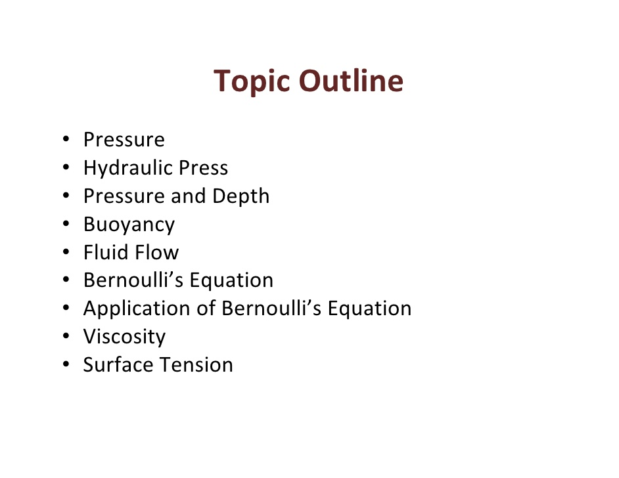

Slide 3
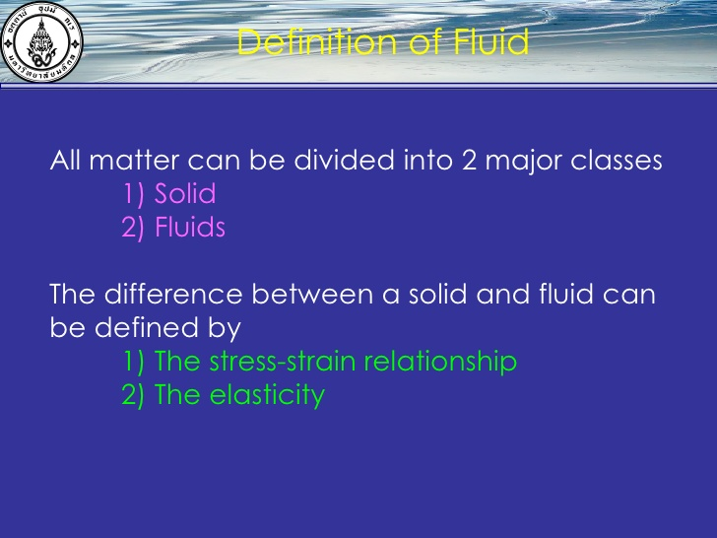

Slide 4

A fluid : is a collection of molecules that are randomly arranged and held together by weak cohesive forces and by forces exerted by the walls of a container. Both liquids and gases are fluids.
يعرف المائع على أن تجمع من الجزيئات تترتب مع بعضها بشكل عشوائي وترتبط فيما بينها بقوى تماسك ضعيفة وبالقوى المبذولة بواسطة جدار الوعاء الذى يحوى المائع. كل من الغازات والسوائل موائع.
First, we consider the mechanics of a fluid at rest—that is, fluid statics

Slide 5
Fluid at Rest
The tree common states or phases
solid | liquid | gas
Fixed shape & size | Can not maintain a fixed shape | Neither a fixed shape nor a fixed volume
Large force applied to solid | Takes on the shape of its container | Expand to fill its container
Does not readily change its shape or volume | Not readily compressible
 | Volume can be changed significantly only by a very large force

Slide 6
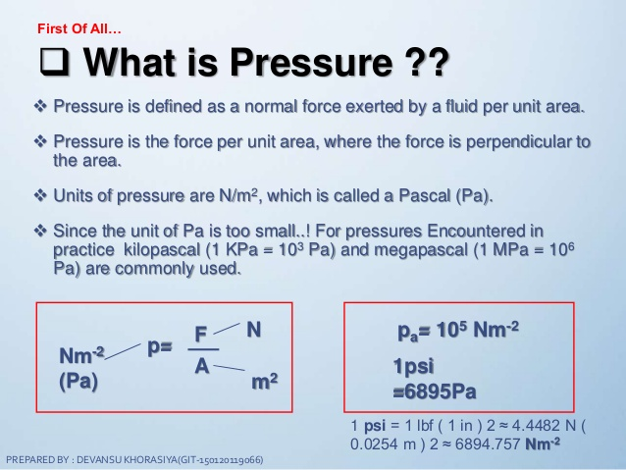

Slide 7
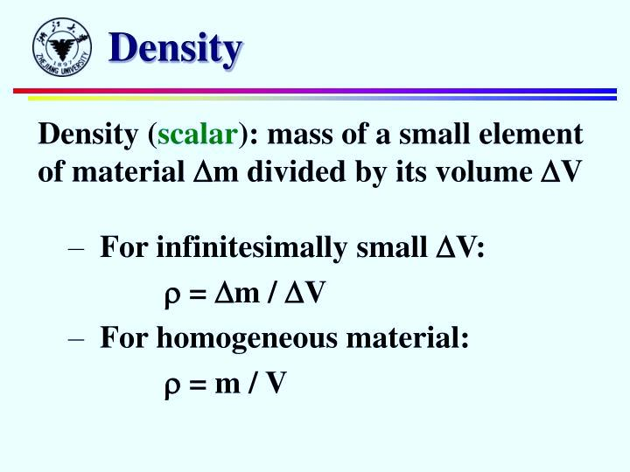

Slide 8
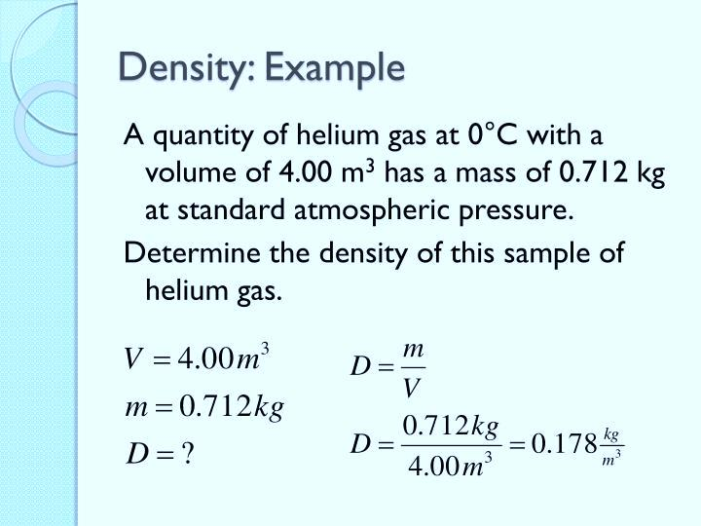

Slide 9
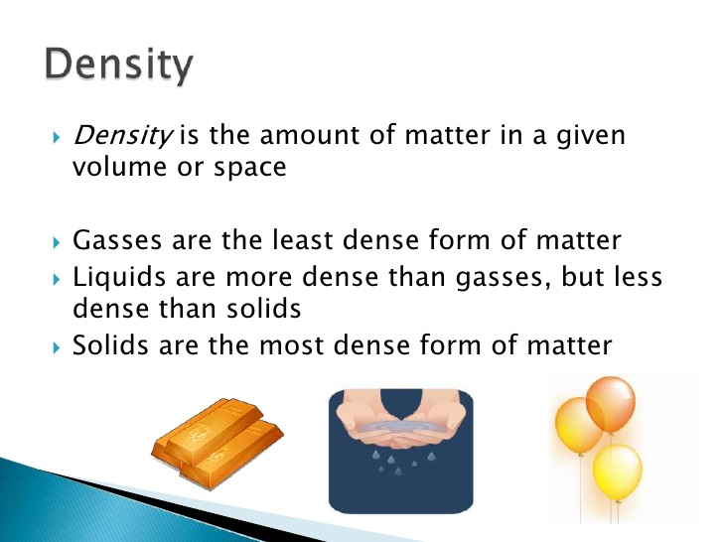

Slide 10
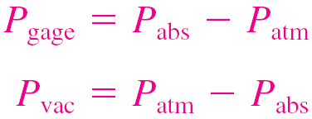
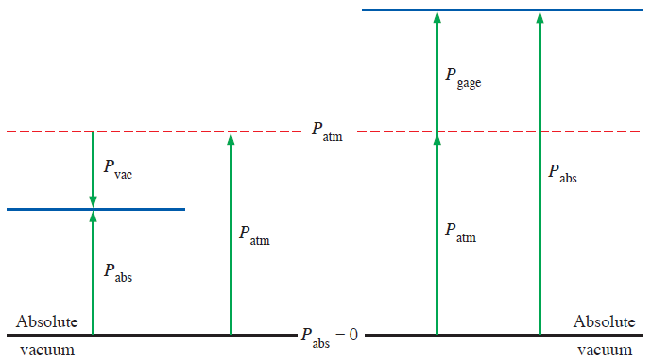
Absolute pressure: The actual pressure at a given position. It is measured relative to absolute vacuum (i.e., absolute zero pressure).
Gage pressure: The difference between the absolute pressure and the local atmospheric pressure. Most pressure-measuring devices are calibrated to read zero in the atmosphere, and so they indicate gage pressure.
Vacuum pressures: Pressures below atmospheric pressure.
Throughout this text, the pressure P will denote absolute pressure unless specified otherwise.

Slide 11
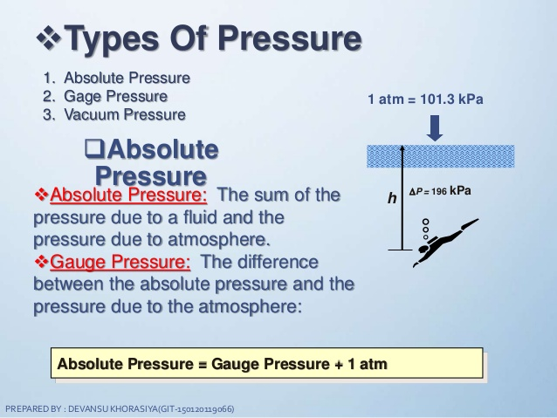

Slide 12
Example: A vacuum gage connected to a chamber reads 5.8psi at a location where the atmospheric pressure is 14.5psi .Determine the absolute pressure in the chamber .
Solution: the gage pressure of a vacuum chamber is given .
the absolute pressure in the chamber is to be determined
Then : P_{abs}=P_{atm} – P_{vac} =14.5-5.8=8.7psi
Discussion : Note that the local value of the atmospheric pressure is used when determining the absolute pressure.

Slide 13
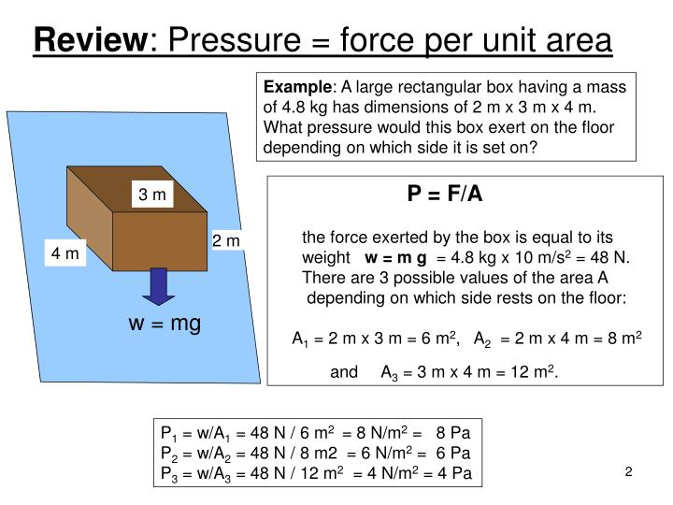

Slide 14
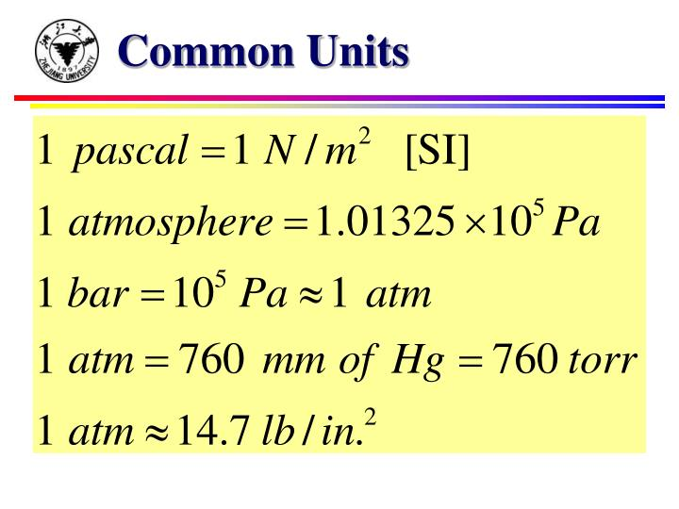

Slide 15
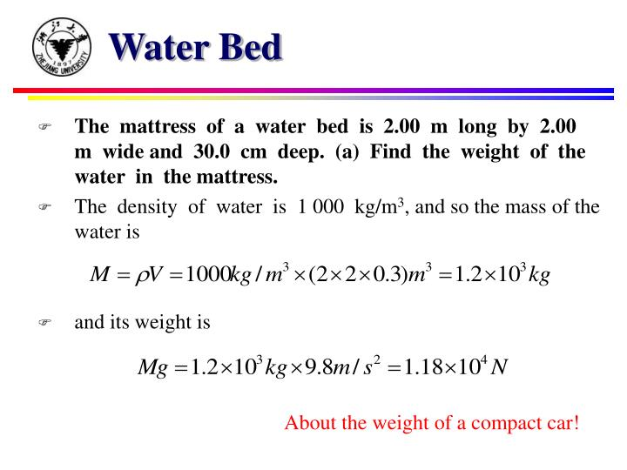

Slide 16
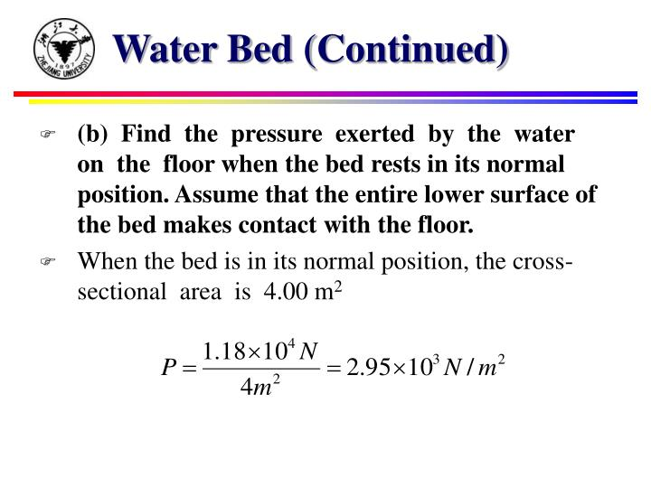

Slide 17
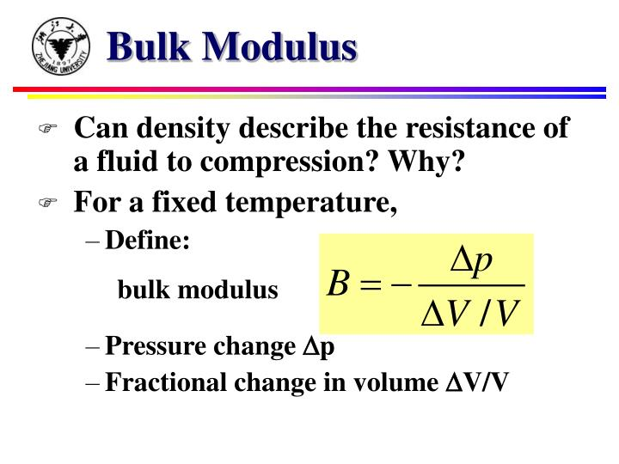

Slide 18
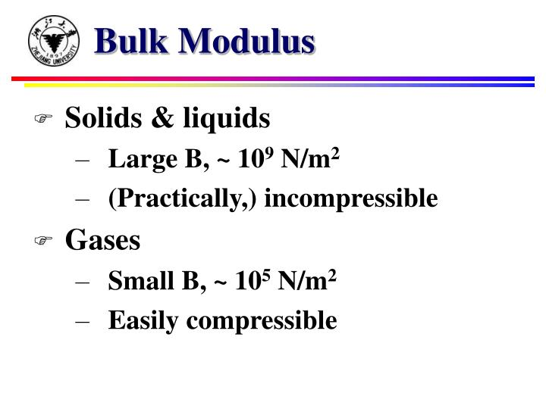

Slide 19
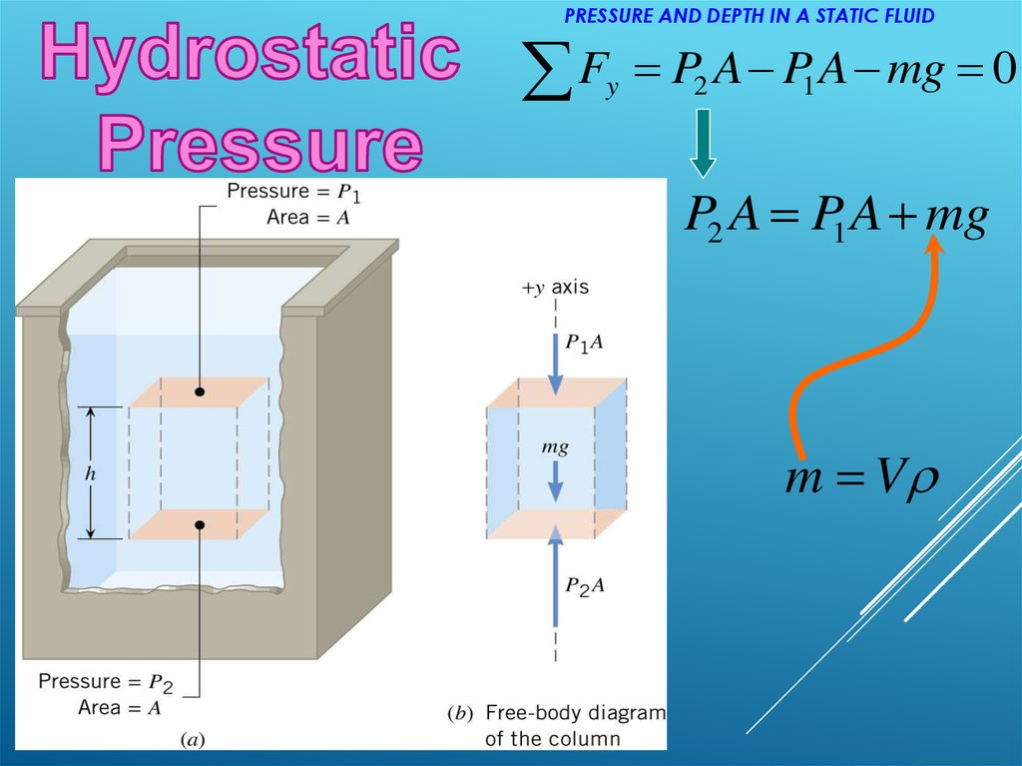

Slide 20
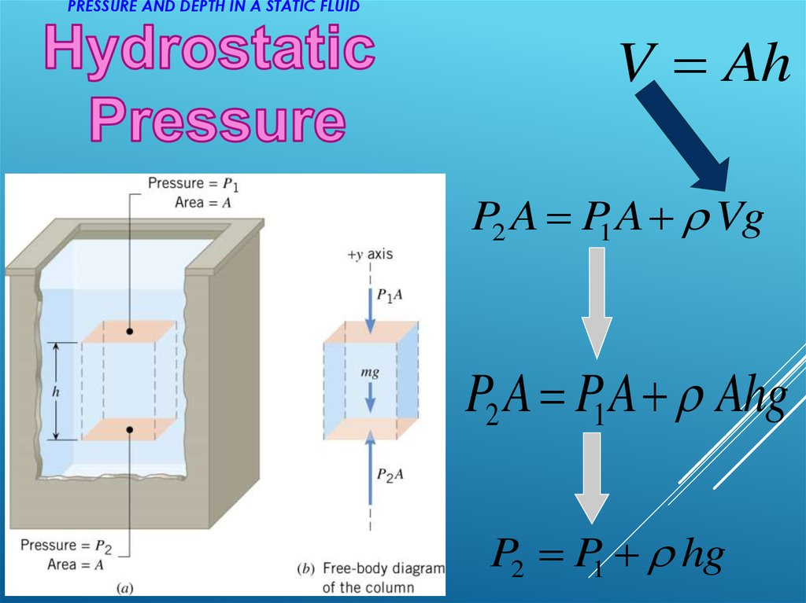

Slide 21
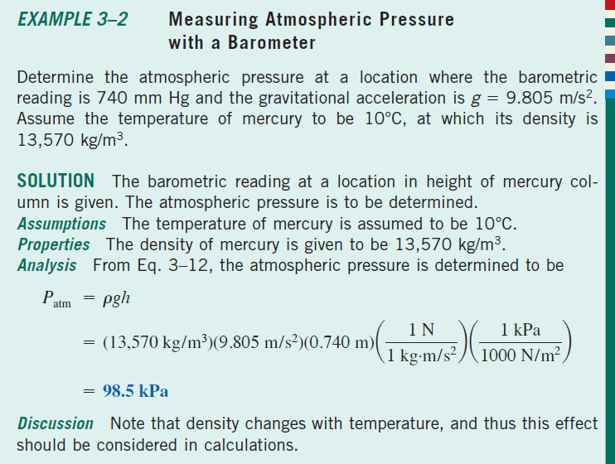

Slide 22
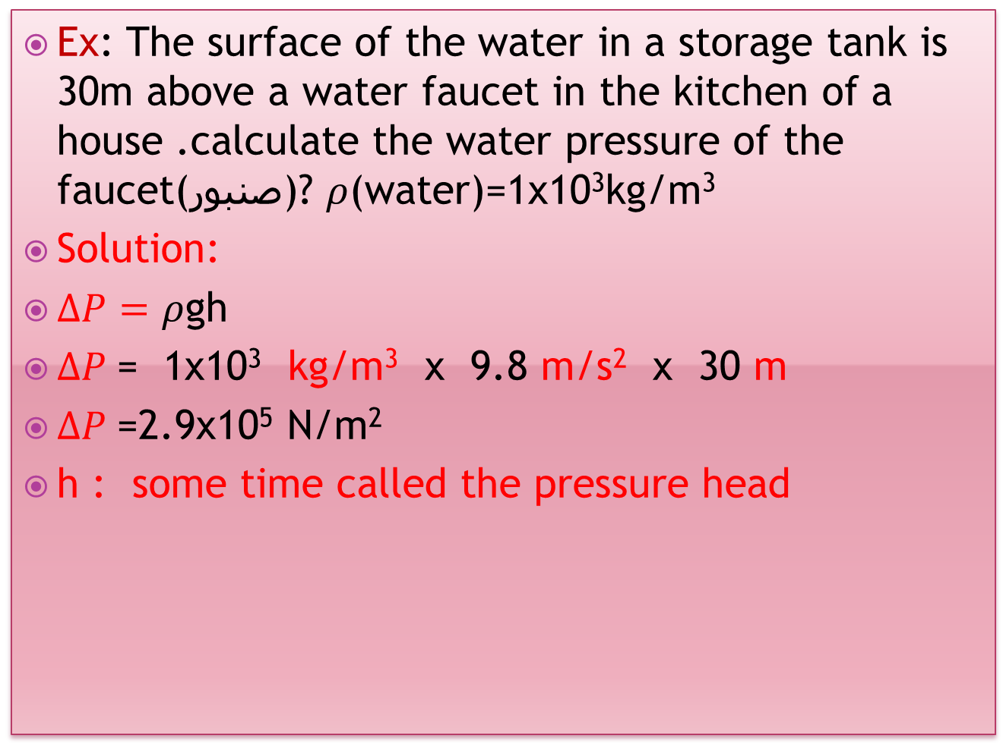
Ex: The surface of the water in a storage tank is 30m above a water faucet in the kitchen of a house .calculate the water pressure of the faucet(صنبور)? $ρ$(water)=1x10³kg/m³
Solution:
$∆P=ρ$gh
$∆P$= 1x10³ kg/m³ x 9.8 m/s² x 30 m
$∆P$=2.9x10⁵ N/m²
h : some time called the pressure head

Slide 23
Example 1.
The mattress of a water bed is 2.00 m long by 2.00 m wide and 30.0 cm deep. (a) Find the weight of the water in the mattress and the pressure exerted by the water on the floor when the bed rests in its normal position. Assume that the entire lower surface of the bed makes contact with the floor.
حمام من الماء طولة 2 m وعرضة 2 mوعمقة30 cm . أوجد (a) وزن الماء في الحمام (b) الضغط المبذول على قاع الحمام.
a-
b-

Slide 24
The Barometer (الباروميتر )
Another instrument used to measure pressure is the common barometer, which. The barometer consists of a long, mercury-filled tube closed at one end and inverted into an open container of mercury Figure (b). The closed end of the tube is nearly a vacuum, and so its pressure can be taken as zero. Therefore, it follows that P₀= ρgh where his the height of the mercury column.
الجهاز الثانى الذى يستخدم في قياس الضغط يسمى بالباروميتر وهو يتكون من أنبوبة طويلة مملوءة بالزئبق تنكس في وعاء مفتوح مملوء بالزئبق. النهاية المغلقة للأنبوبة تقريبا فراغ لذلك يمكن اعتبار الضغط عندها مساويا الصفر وعلى ذلك يكون P₀ = ρgh حيث h هو ارتفاع عمود الزئبق.

Slide 25
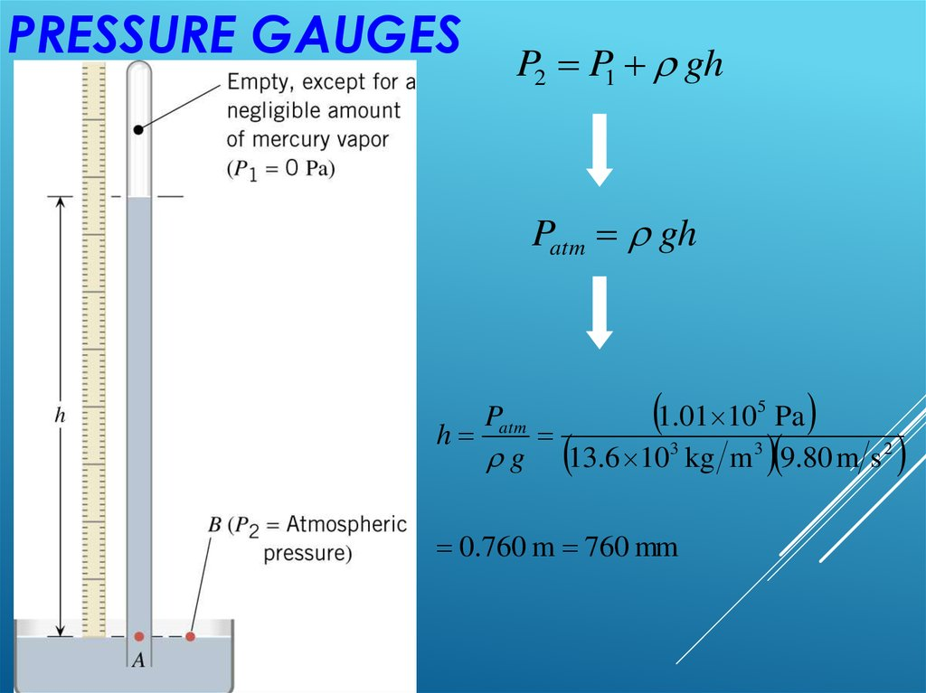

Slide 26
PRESSURE MEASUREMENTS
The Open Tube Manometerالمانومتر ذو الأنبوبة المفتوحة
One simple device for measuring pressure is the open-tube
manometer illustrated in figure ( a ). One end of
a U-shaped tube containing a liquid is open to
the atmosphere, and the other end is connected
to a system of unknown pressure P. The difference
in pressure is equal to
P-P₀ = ρgh ;
hence, The pressure :
P= P₀ +ρgh
is called the absolute pressure, and the difference
is called the gauge pressure.
The latter is the value that normally
appears on a pressure gauge.
For example, the pressure you measure in your bicycle tire is the gauge pressure.
المانومتر ذو الانبوبة المفتوحة يعتبر واحدا من الوسائل المستخدمة لقياس الضغط ويتكون من أنبوبة على شكل حرف U تحتوى على سائل . أحد طرفيها معرض للهواء بينما الطرف الثانى يوصل بالوعاء المراد قياس ضغطة فيكون فرق الضغط P-P₀ = ρgh لذلك يكون الضغط
P = P₀ + ρgh

Slide 27
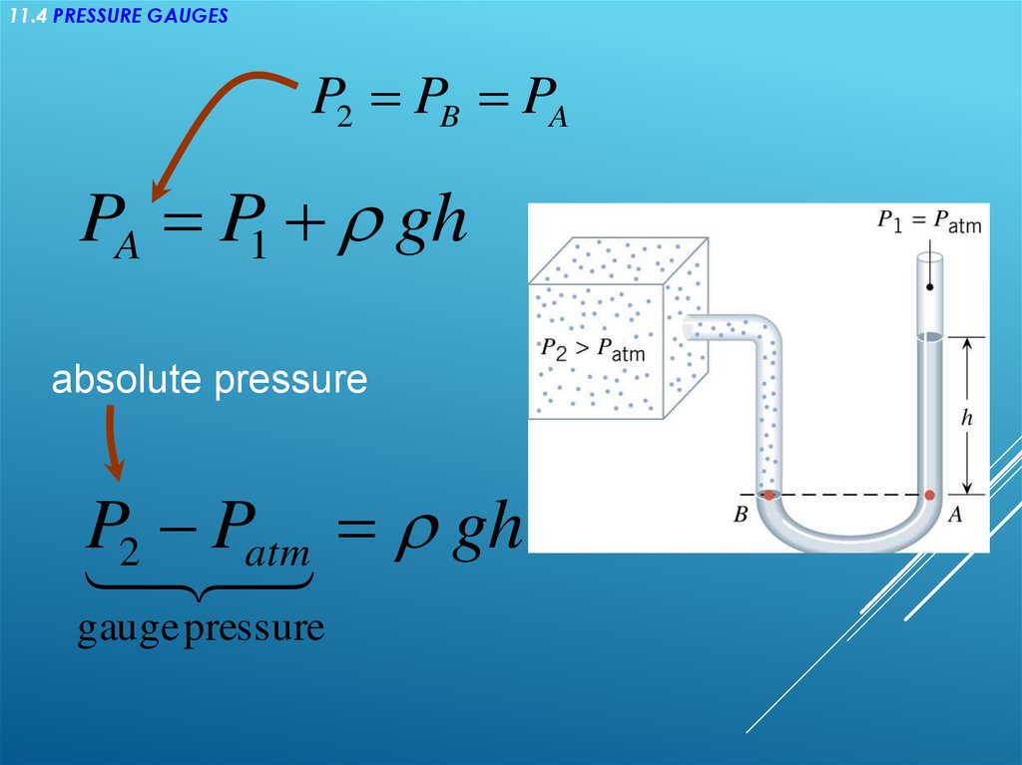

Slide 28
